Slide 1
Lecture 31

Slide 2
Question 123.15.4
Approximately what is the average velocity of the molecules in this room?
478m/s
1901m/s
101005m/s
0m/s

Slide 3
Diatomic Molecule
z
y
x

Slide 4
Rotational Degrees of Freedom
z
y
x

Slide 5
Vibrational Degrees of Freedom
z
y
x

Slide 6
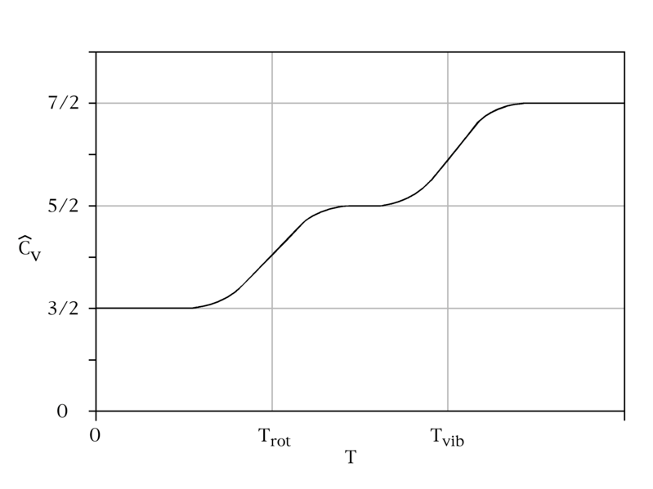
C_{v} vs Temperature

Slide 7
Energy States of a Diatomic Molecule
Available Energy States
Vibrational State
3p
Electronic
State
Roptational State
Increasing Energy
Possible Energy Transitions
2s
Electronic
State

Slide 8
Model of a Solid
z
y
x

Slide 9
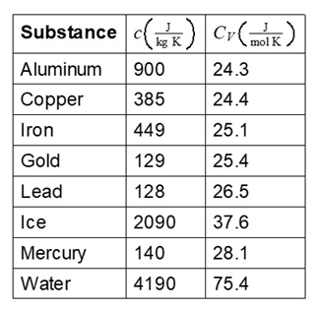

Slide 10
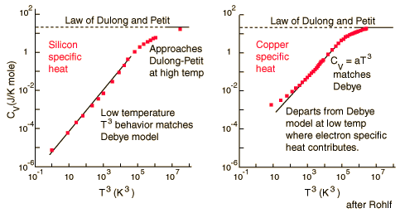
Dulong and Petit Law
http://hyperphysics.phy-astr.gsu.edu/Hbase/thermo/dulong.html

Slide 11
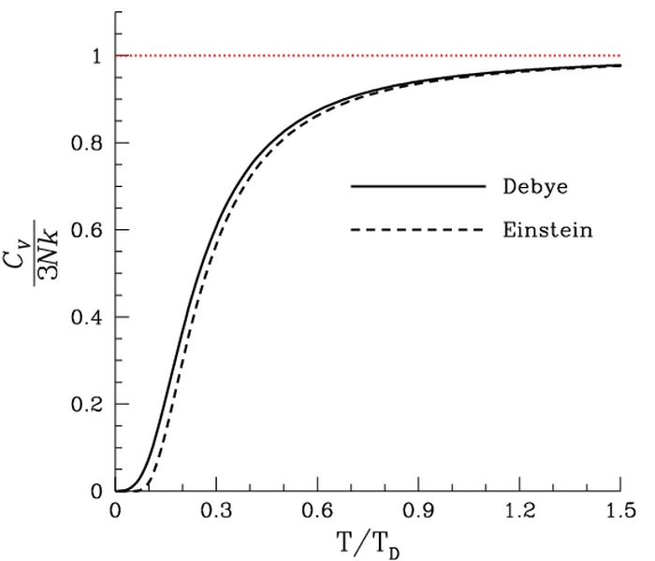

Slide 12
Question 123.14.1.5
A car is driving down I-20 at 70mph (speed limit). Does the center of mass of the car have the same kinetic energy as a piston in the engine?
Yes
No
Maybe
Wait, the speed limit changed?

Slide 13
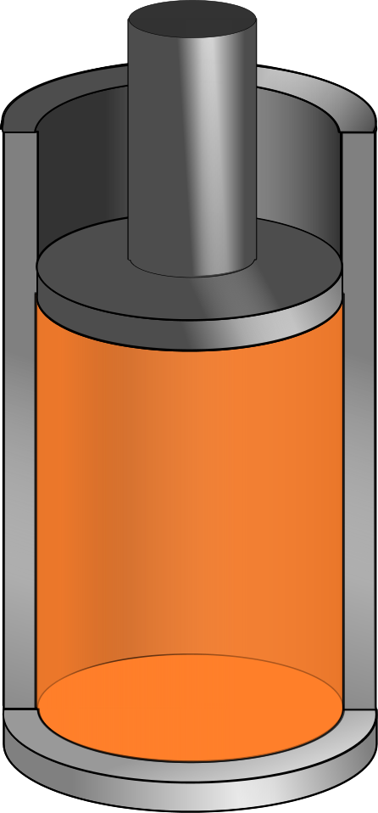
v_{system}
v_{molecule}
V
P
n
T

Slide 14
Question 123.14.1
We have two gases, each with the same values of n, V and T. One gas is Hydrogen, the other is Nitrogen. For which gas is the rms speed larger?
Hydrogen
Nitrogen

Slide 15
Question 123.14.2
If the temperature increases, the peak of the Maxwell-Boltzmann speed distribution
Increases to a higher velocity
Decreases to a lower velocity
Stays the same
Can’t tell

Slide 17
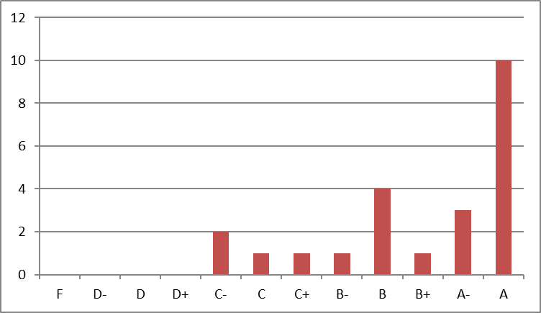
Number of students whose score was between 90 and 93
Number of students whose score was between 83 and 87

Slide 18
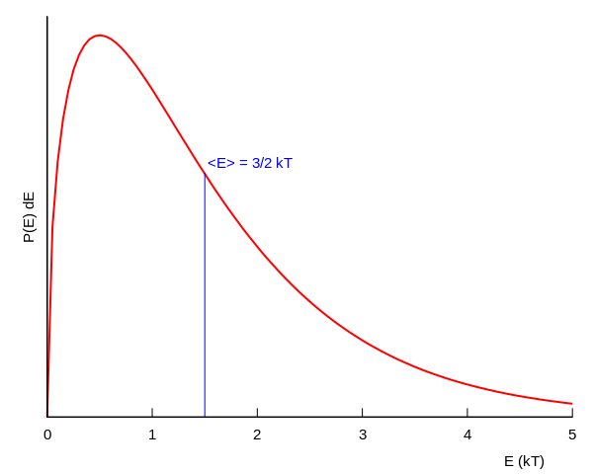
Boltzmann Distribution

Slide 19
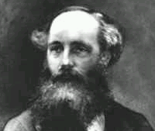
Found an expression for the Molecular Speed Distribution
James Clerk Maxwell (1831-1879)

Slide 20
dv
v

Slide 21
N - total number of molecules

Slide 22
Question 123.14.2
If the temperature increases, the peak of the Maxwell-Boltzmann speed distribution
Increases to a higher velocity
Decreases to a lower velocity
Stays the same
Can’t tell

Slide 23
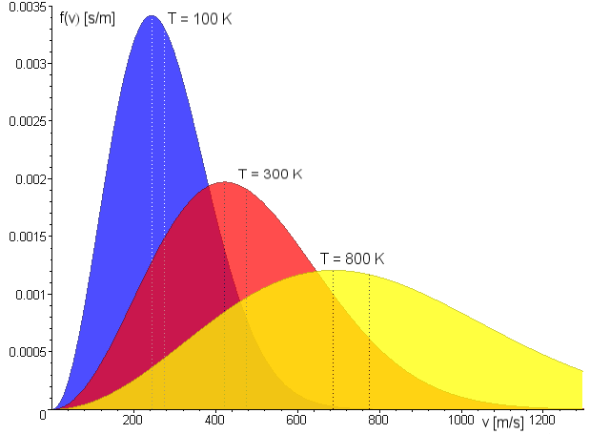
Maxwell Distribution
A system of gas at a given temperature will exhibit a variety of speeds
Three speeds are of interest:
Most probable
Average
rms
Image in the Public Domain couracy Fred Stober

Slide 24
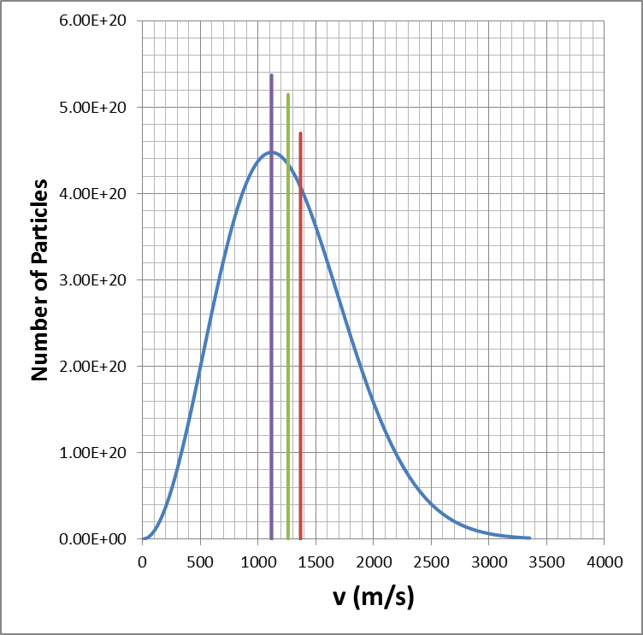
Molecular Speeds

Slide 25
END

Slide 26
END

Slide 27
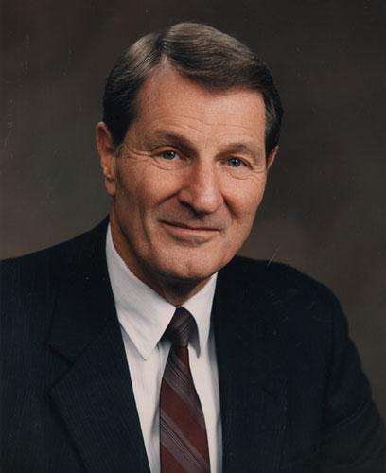
Not the same guy
Neal A. Maxwell
(1926-2004)

Slide 28
Question 123.17.1
The useful work that comes from and engine is equal to
-W
Q
ΔE_{int}
PV

Slide 29
Δx
P
F_{gas}
F_{external}
Q
V
V_{i}
V_{f}

Slide 30
Hot Reservoir at T_{h}
Q_{h}
Q_{c}
Cold Reservoir at T_{c}

Slide 31
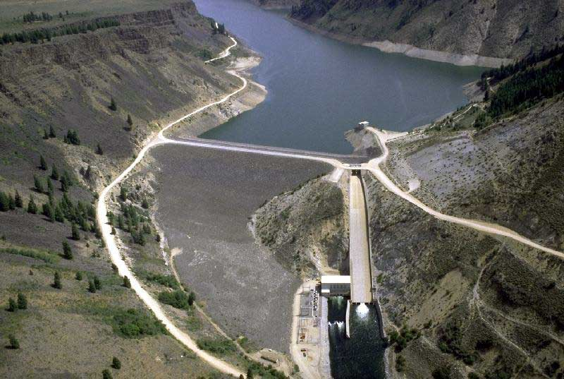
The picture shows the Anderson Ranch Dam and Reservoir.
If I take out a cup of water out of the reservoir, how much do the volume and the pressure of the water change?
Volume goes up, pressure down
Volume goes down pressure goes up
c) Volume goes down pressure goes down
d) You wouldn’t notice any difference

Slide 32
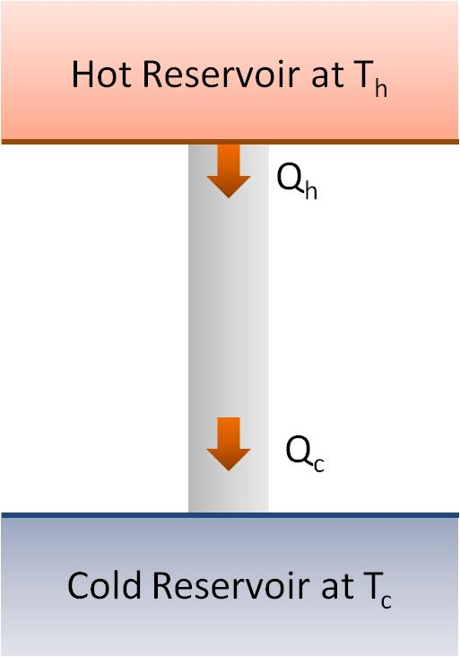
Question 123.17.2
By how much does the temperature of the hot reservoir change as Q_{h} leaves?
0K
10K
100K
1000K

Slide 33
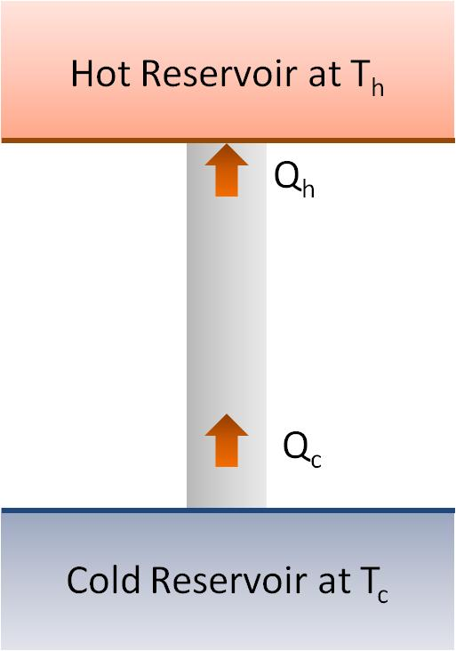
Question 123.17.3
What would you call the process shown in the energy transfer diagram
Adiabatic
Isobaric
Isothermal
Impossible

Slide 34
Question 123.17.4
What does the energy transfer diagram mean?
Heat is turned into useful work
Work is turned into waste energy
Energy is turned into useful work
This is an impossible process

Slide 35
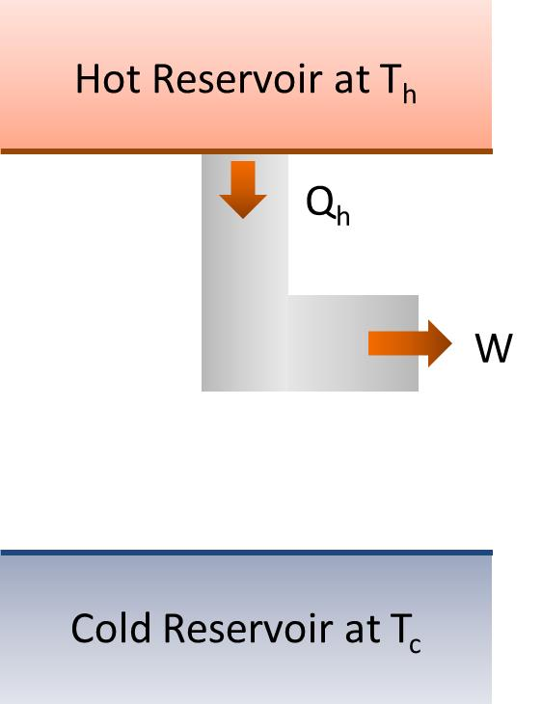
Question 123.17.4.5
What would you call the process shown in the energy transfer diagram
Adiabatic
Isobaric
Isothermal
Impossible

Slide 36
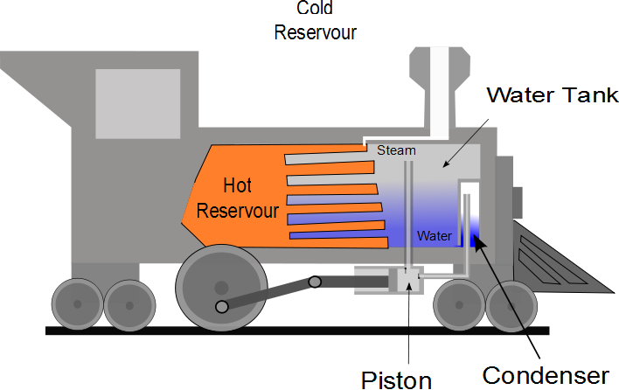

Slide 37
P
W_{eng} = Area
V

Slide 38
Question 123.17.5
Suppose I tell you I have an engine that has and efficiency e=1, what is Q_{c} for this engine?
0
W_{eng}+ Q_{h}
W_{eng}- Q_{h}
W_{eng}

Slide 39
Question 123.17.6
If I tell you I have a heat engine which operates with Q_{c} = 0, what should you do?
Buy Stock in my company
See if you can get your hands on the secret plans
Applaud the wonderful engineering achievement
Tell me I am lying (Kindly, this is BYU-I)

Slide 40
Question 123.17.7
It is a hot day. You don’t have and air conditioner, but you have a refrigerator. You open the door of the fridge. The air in your apartment
Gets cooler
Gets hotter
Stays the same
Can’t tell

Slide 41
Hot Reservoir at T_{h}
Q_{h}
Refrigerator
W
Q_{c}
Cold Reservoir at T_{c}

Slide 42
Hot Reservoir at T_{h}
Q_{h}
Q_{c}
Cold Reservoir at T_{c}

Slide 43
Hot Reservoir at T_{h}
Q_{h}
Q_{c}
Cold Reservoir at T_{c}

Slide 44
Hot Reservoir at T_{h}
W
Q_{c}
Cold Reservoir at T_{c}

Slide 45
Hot Reservoir at T_{h}
Q_{h}
W
Cold Reservoir at T_{c}

Slide 46
Hot Reservoir at T_{h}
Q_{h}
W
Cold Reservoir at T_{c}

Slide 47
Hot Reservoir at T_{h}
Q_{h}
Engine
W_{engine}
Q_{c}
Cold Reservoir at T_{c}

Slide 48
Hot Reservoir at T_{h}
Q_{h}
Engine
W_{engine}
Cold Reservoir at T_{c}

